Slide 1
PROJECT
IOT BASED ON HOME AUTOMATION
Emertxe Technologies
Internship : IoT
Presented by :
NAME :
PRAJWAL P KASHYAP
EMAIL :
prajwalpkashyap.cskit2020@gmail.com

Slide 2

CONTENTS
TOPICS LEARNT DURING INTERNSHIP
WHAT IS IOT?
IOT ARCHITECTURE
WHAT IS EMBEDDED SYSTEM
PROJECT REQUIREMENTS
REQUIREMENTS
SCREENSHOTS
CONCLUSION
IMPLEMENTATION

Slide 3

TOPICS LEARNT DURING INTERNSHIP
C Programming
Keywords
Basic data types --- int, char, float, double, void Operators
Conditional constructs and Looping concepts Arrays
Pointers Functions --- Built-in and User defined functions
Storage Classes Pre-processor directives and header files

Slide 4
TOPICS LEARNT DURING INTERNSHIP
C++ Programming
OOP concepts
Introduction to IoT Definition of IoT IoT Architecture
Introduction to Embedded systems Definition Types of Embedded systems Components of Embedded systems
Peripherals LED
Arduino Uno
CLCD -- 14 pins description of CLCD
ADC --- Use of ADC in Arduino

Slide 5
Peripherals required for the Project
LDR Sensor
To read the sensor values and based on the reading vary the brightness of LED(Garden lights).
Temperature System
It consists of heater, cooler, LM35 (temperature sensor). We can read the temperature from the temperature sensor
Serial Tank
We can read the volume of the water in the tank through serial communication

Slide 6
WHAT IS IOT?
The Internet of Things (IoT) is the network of physical objects that contain embedded technology to communicate and sense or interact with their internal states or the external environment.
These devices range from ordinary household objects to sophisticated industrial tools. With more than 7 billion connected loT devices today, experts are expecting this number to grow to 10 billion by 2020 and 22 billion by 2025.
By means of low-cost computing, the cloud, big data, analytics, and mobile technologies, physical things can share and collect data with minimal human intervention. In this hyper connected world, digital systems can record, monitor, and adjust each interaction between connected things. The physical world meets the digital world-and they cooperate.

Slide 7
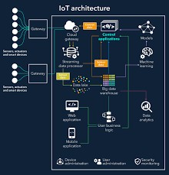
IOT Architecture

Slide 8
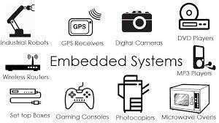
WHAT IS EMBEDDED SYSTEM?
Any combination of hardware and software which is intended to do a specific task can be called an Embedded System
It has 3 parts; software, firmware and hardware.
Unlike computers, embedded systems perform few specific limited tasks.
Embedded Devices have peripherals such as Serial Communication Interfaces (SCI), Synchronous Serial Communication Interface, Universal Serial Bus (USB), Multi Media Cards (SD cards, Compact Flash) etc.

Slide 9
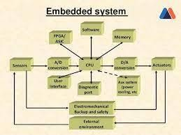
EMBEDDED SYSTEM

Slide 10
PROJECT REQUIREMENTS
Control garden lights on basis of sunlight intensity: Lesser the sunlight brighter the garden lights
Temperature system control: Switch heater and cooler ON or OFF remotely. Switch heater OFF automatically if temperature indoors exceeds 35' C.
Water tank control: Switch inlet and outlet valve ON or OFF remotely. Switch inlet valve OFF automatically if the tank fills up. Switch inlet valve ON automatically if volume of tank drops below 2000L

Slide 11
REQUIREMENTS
HARDWARE REQUIREMENTS
:
ARDUINO UNO
ETH-W5500
PCF-8574
SOFTWARE REQUIREMENTS
ARDUINO IDE : To code PICSIMLAB: For simulation
NULL MODEM EMULATOR : To configure ports of serial remote tank
Blynk IOT app : Cloud server
TEMPERATURE SENSOR •
LCD HD44780
LDR SENSOR
LED

Slide 12
ARDINO UNO
Arduino UNO is based on an ATmega328P microcontroller.
It is easy to use compared to other boards, such as the Arduino Mega board, etc. The board consists of digital and analog Input / Output pins (I/O), shields, and other circuits.
The Arduino UNO includes 6 analog pin inputs, 14 digital pins , a USB connector, a power jack, and an ICSP (In-Circuit Serial Programming) header.
It is programmed based on IDE, which stands for Integrated Development Environment. It can run on both online and offline platforms

Slide 13
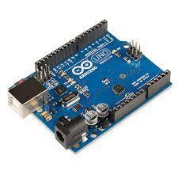

Slide 14
ETH W5500
The W5500 chip is a Hardwired TCP/IP embedded Ethernet controller that provides easier Internet connection to embedded system.
W5500 enables users to have the Internet connectivity in their applications just by using the single chip in which TCP/IP stack, 10/100 Ethernet MAC and PHY embedded.
Supports Power down mode.
Supports Wake on LAN over UDP . Supports High Speed Serial Peripheral Interface(SPI MODE 0,3).

Slide 15
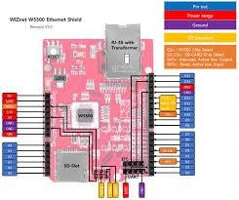

Slide 16
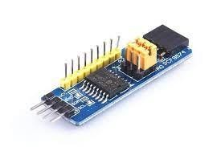
PCF 8574
The PCF8574 is a silicon CMOS circuit
It provides general purpose remote I/O expansion for most
microcontroller families via the two-line bidirectional bus (12C).
The device consists of an 8-bit quasi-bidirectional port and an I2C-bus interface.

Slide 17
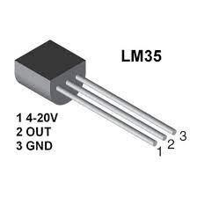
TEMPERATURE SENSOR
A Temperature sensor is an electronic device that measure the temperature of its environment and converts the input data into electronic data to record, monitor, or signal Temperature changes.

Slide 18
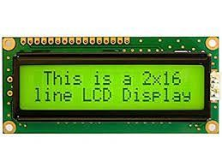
LCD HD44780
LCD HD44780 is dot-matrix liquid crystal display controller and
driver LSI displays alphanumeric and symbols .
It can be configured to drive a dot-matrix liquid crystal display under the control of a 4 or 8-bit microprocessor.

Slide 19
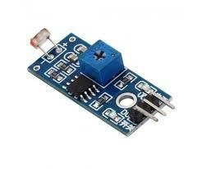
LDR SENSOR
An LDR is a component that has a (variable) resistance that changes with the light intensity that falls upon it. This allows them to be used in light sensing circuits .
The resistance of a Photo resistor decreases with increasing incident light intensity. In other words, it exhibits photoconductivity.

Slide 20
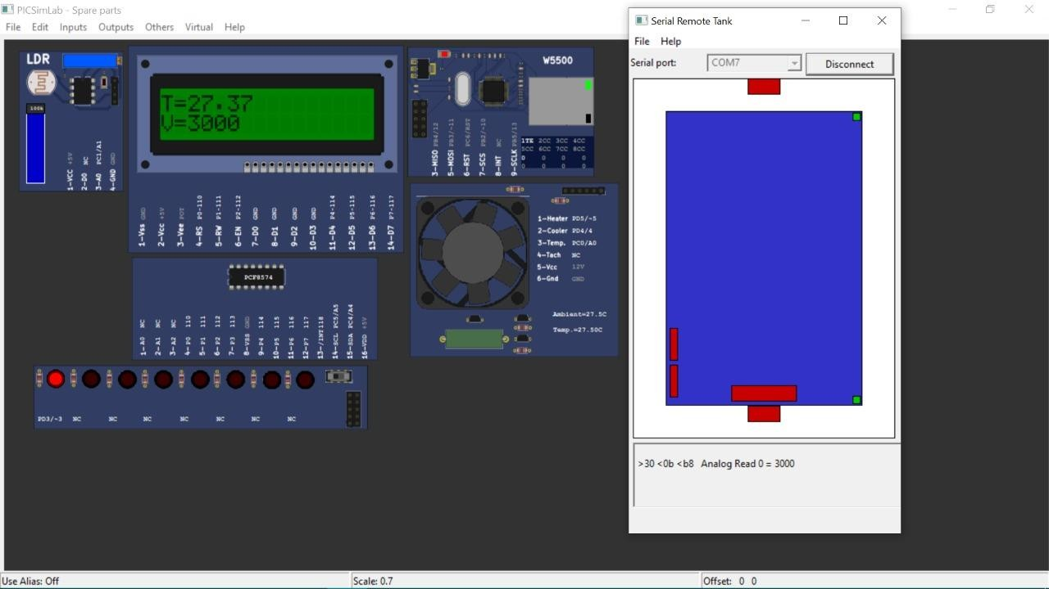
Step 1 :- When we load the hex file

Slide 21
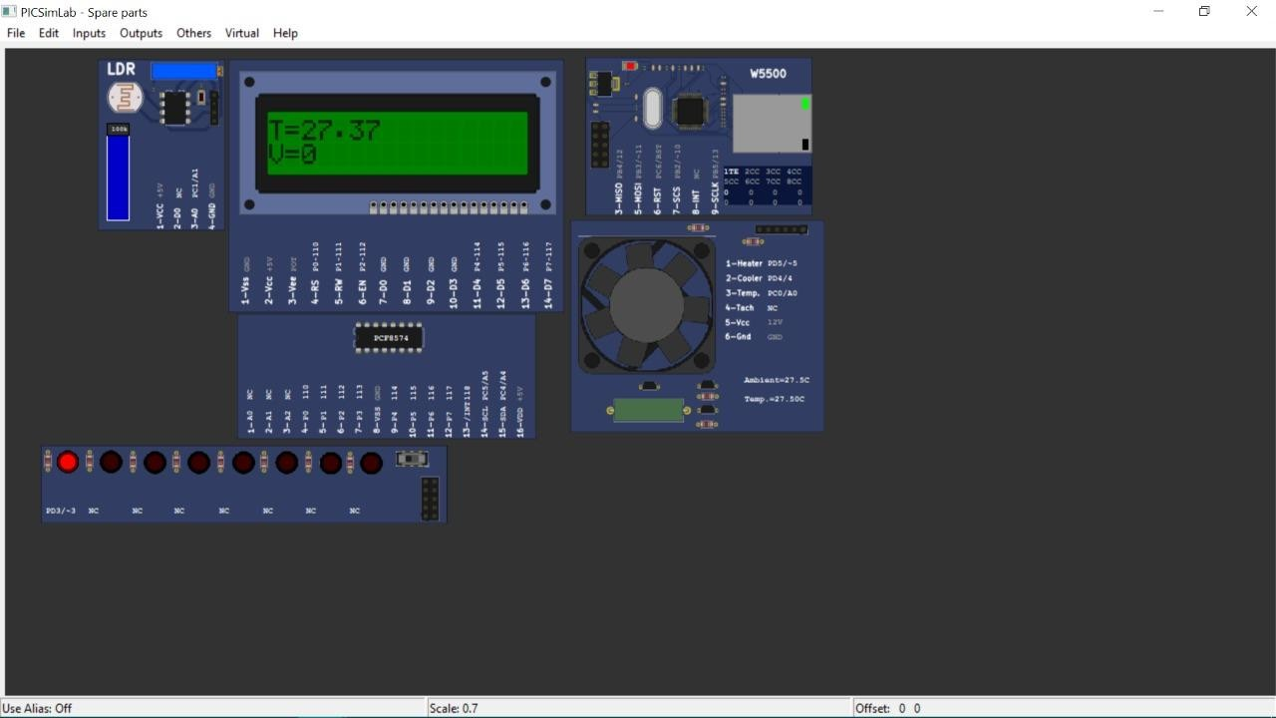
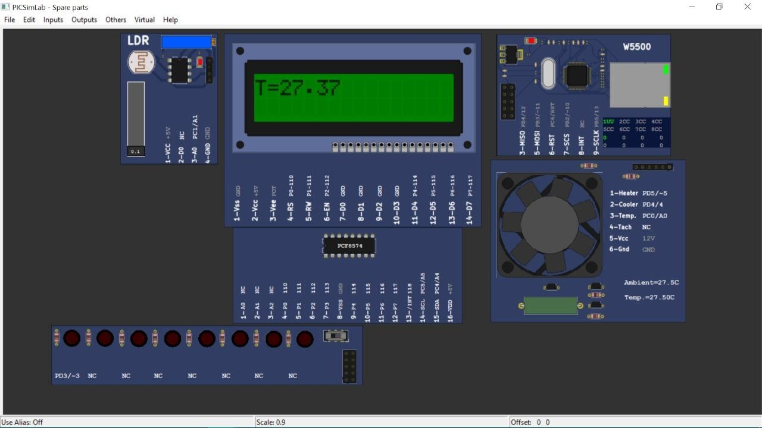
LDR is HIGH so LED is ON
LDR is LOW so LED is OFF

Slide 22

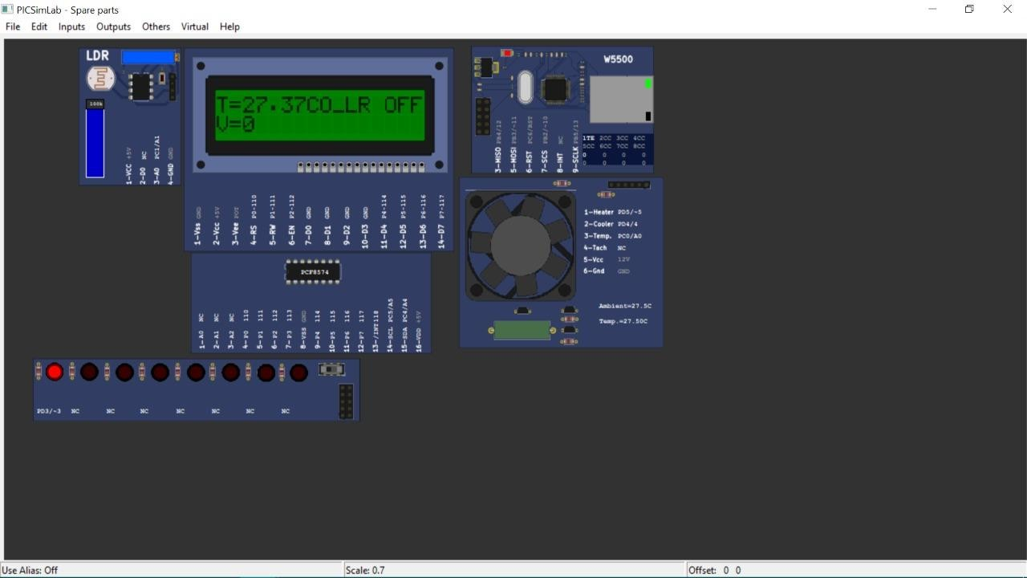
Cooler is ON
Cooler is OFF

Slide 23

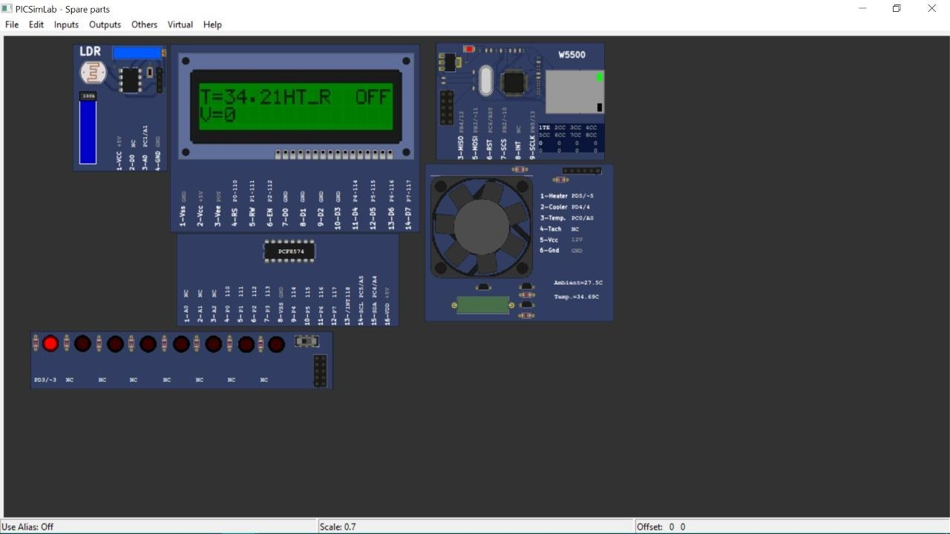
Heater is ON
Heater is OFF

Slide 24
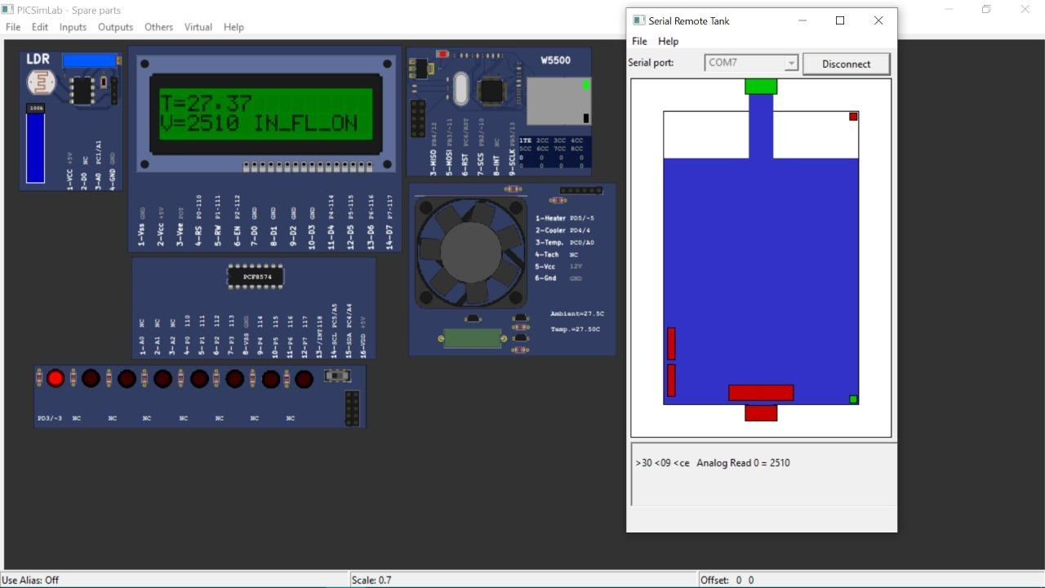
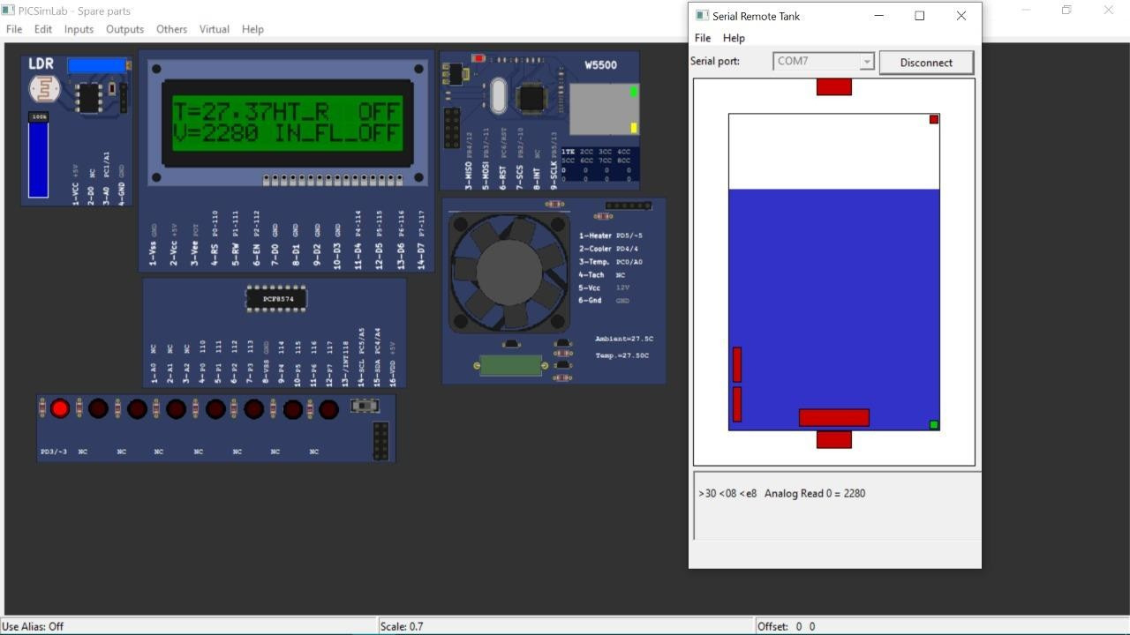
Inlet Valve is ON
Inlet Valve is OFF

Slide 25
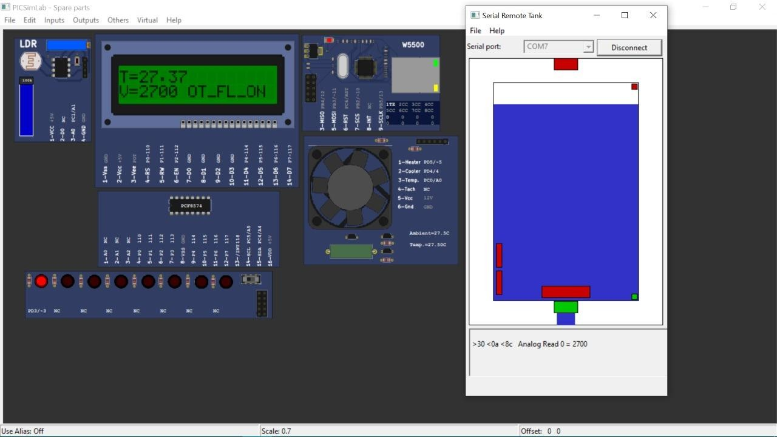

Outlet Valve is ON
Outlet Valve is OFF

Slide 26
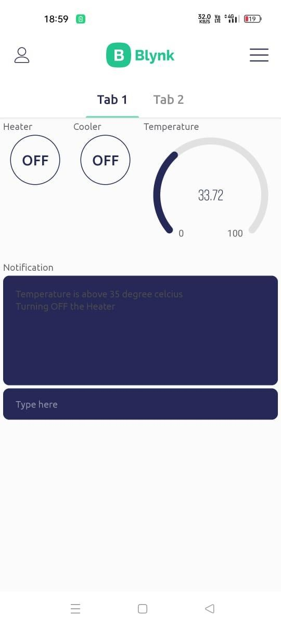
Notification of heater temperature

Slide 27
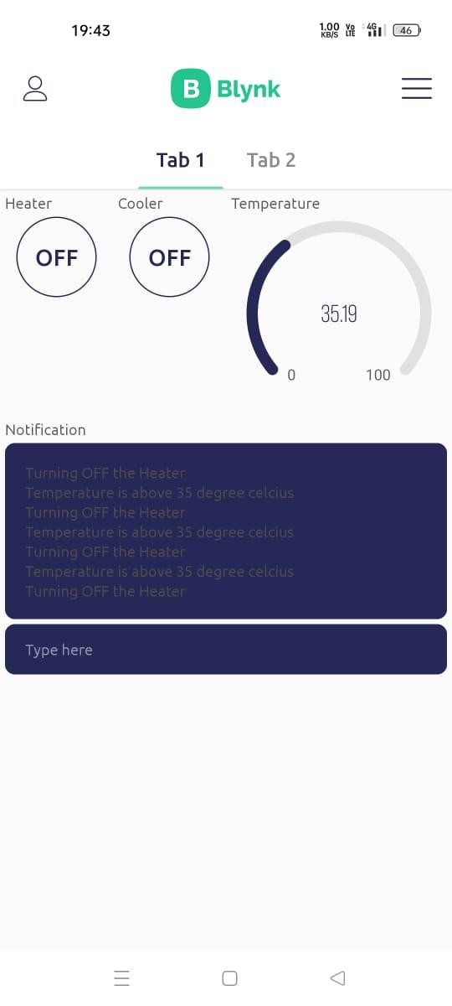
Heater will automatically turn OFF when temperature rises above 35

Slide 28
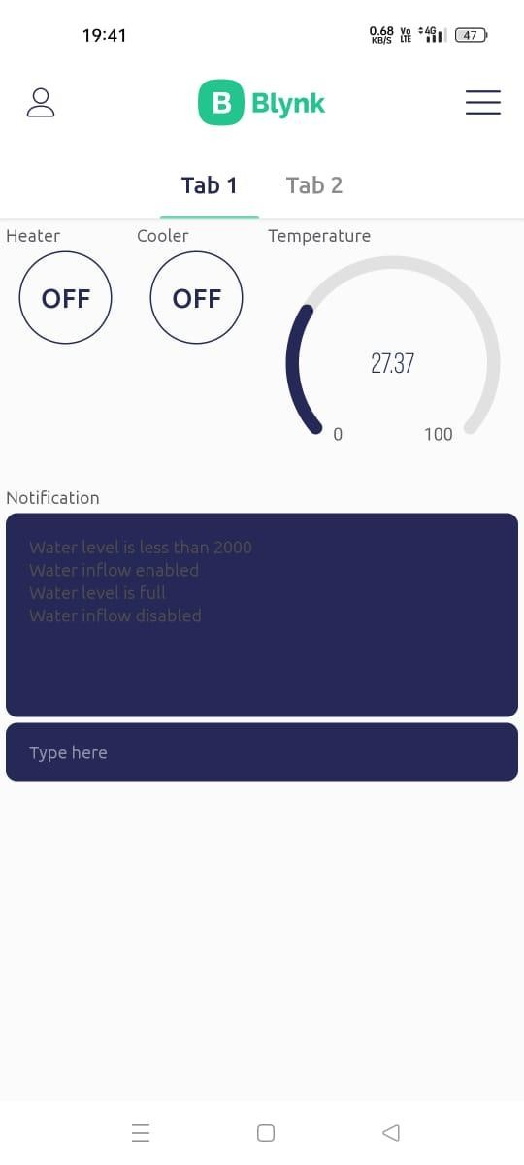
Notification of water level

Slide 29
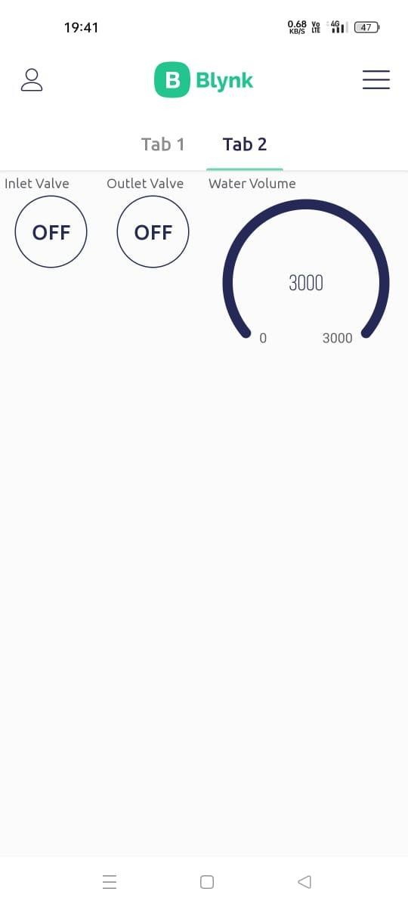
Water tank is full - Inlet valve will automatically turn OFF

Slide 30
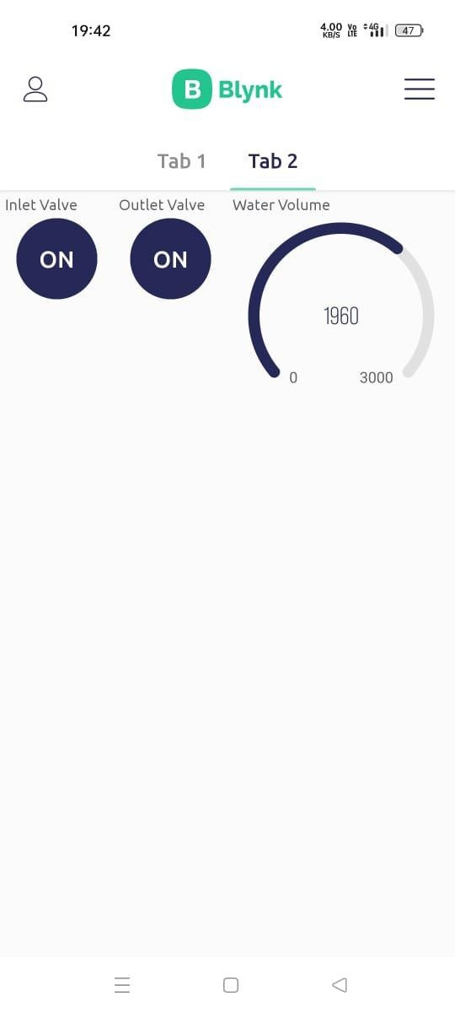
Water volume level

Slide 31
CONCLUSION
Using BLYNK lot application and Picsimlab simulator, simulated home automation, where LED, temperature system, Serial tank resembles Light, Heater, Cooler and Water tank in real time.
CLCD acts like a dashboard used for displaying the events, Widgets from Blynk Iot app like button widgets are used to control heater, cooler and inlet valve, outlet valve .
Gauge widgets to display the temperature and volume of the water.

Slide 32
THANK YOU
Presented by :
NAME : PRAJWAL P KASHYAP
EMAIL : prajwalpkashyap.cskit2020@gmail.com

